Slide 1
Microplastics in Marine Sediments and Rabbitfish (Siganus fuscescens) from Selected Coastal Areas of Negros Oriental,Philippines

Slide 2
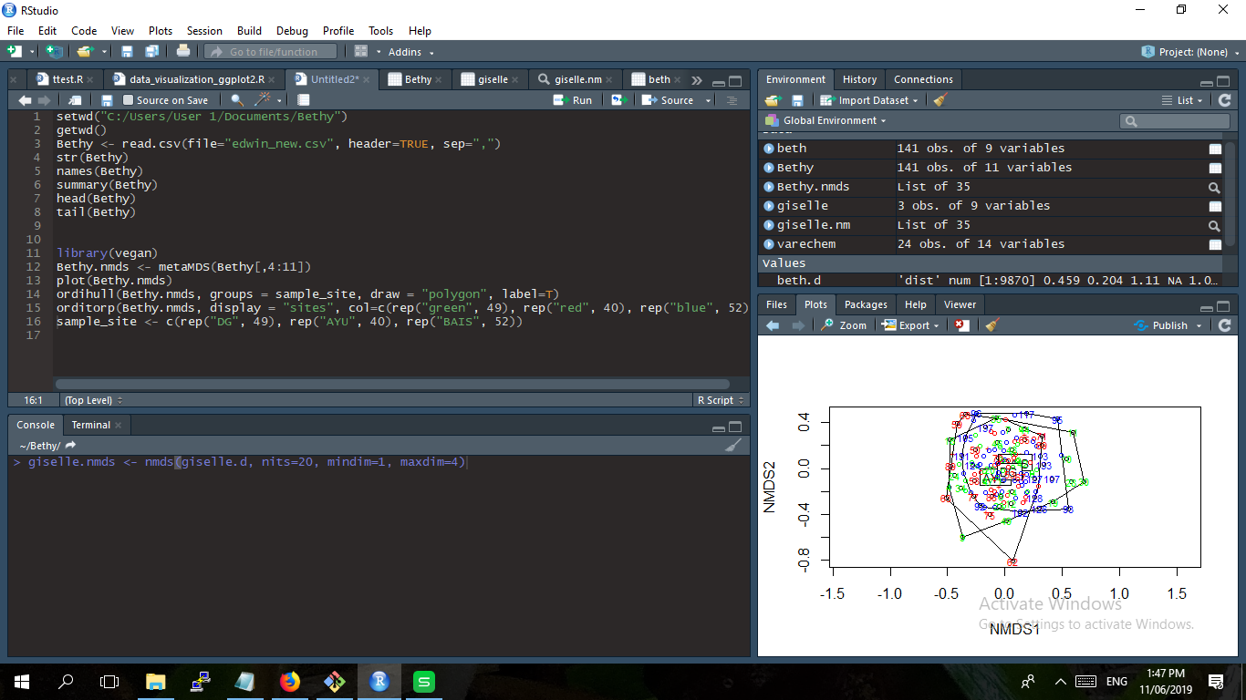

Slide 3
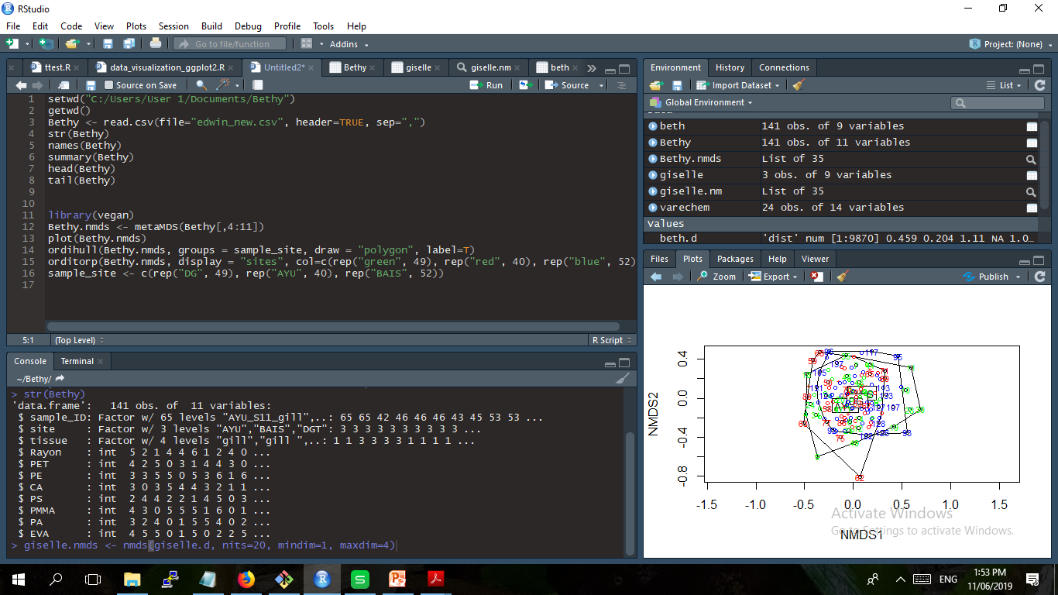

Slide 4
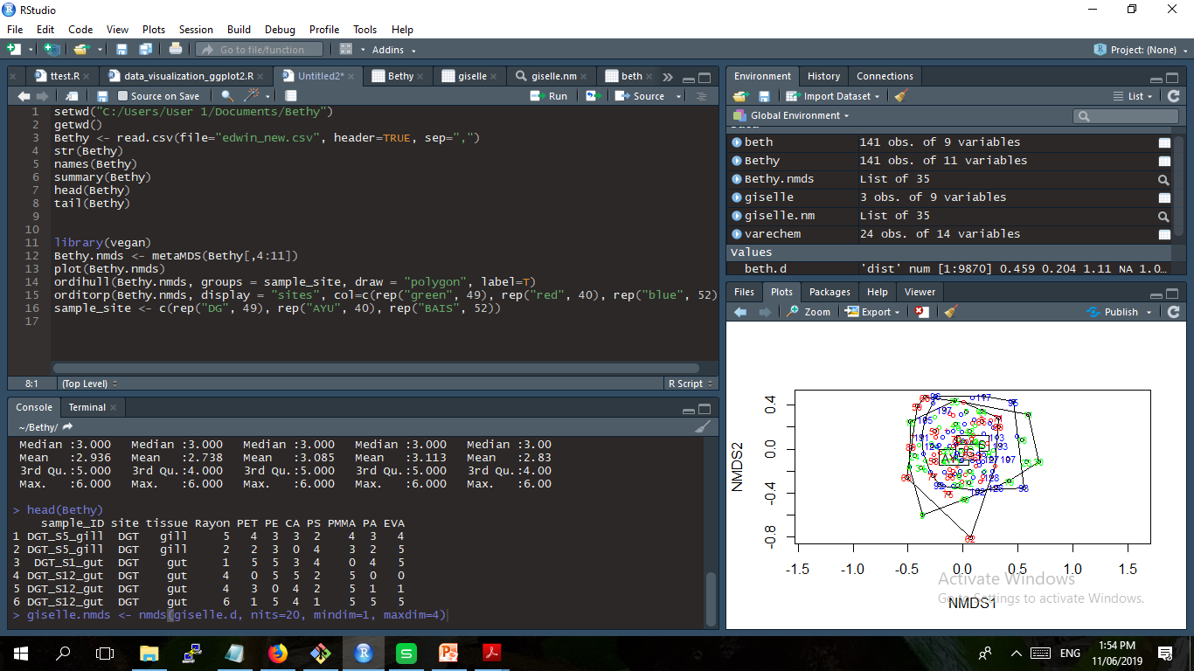

Slide 5
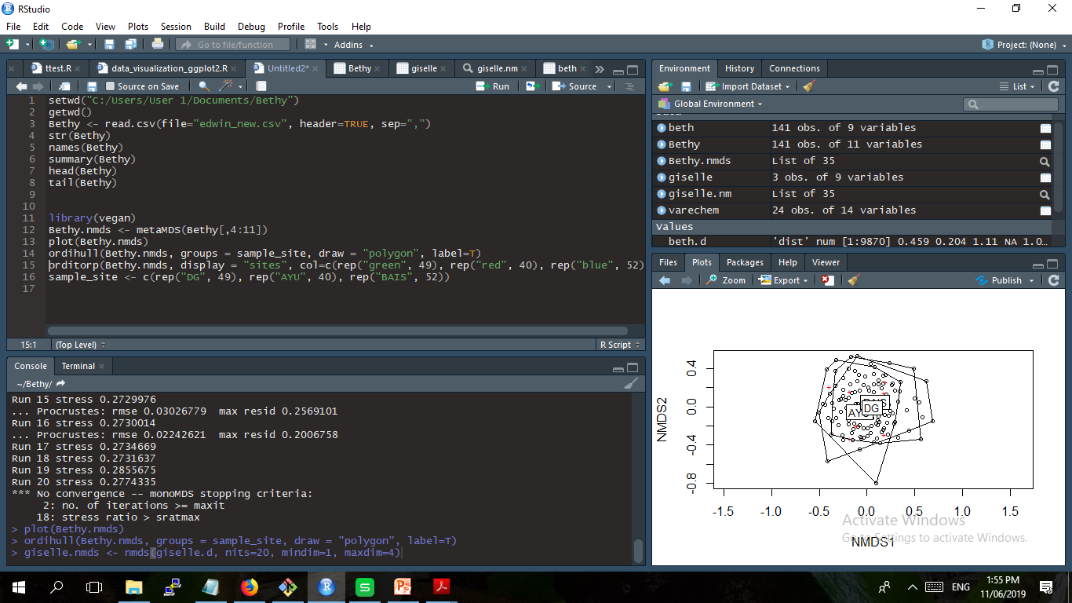

Slide 6
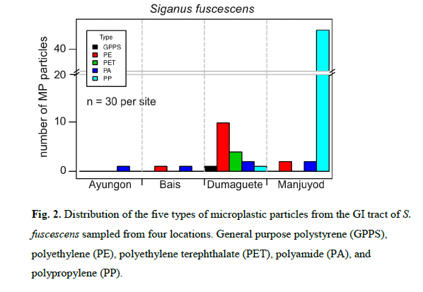

Slide 7
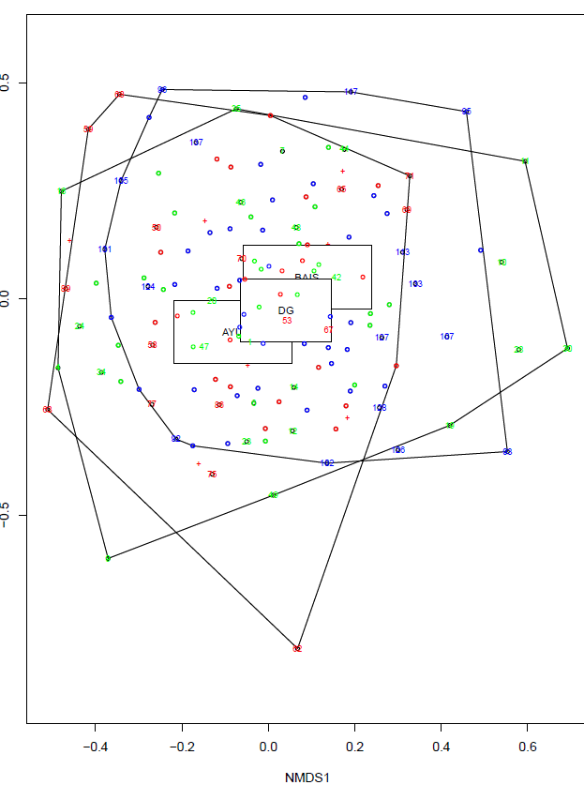

Slide 8
